Slide 1
Analysing Data
Miss L
Year 8

Slide 2
From Last Lesson
Find the mean, median, mode and range for the following data set:
4, 8, 9, 9, 9, 10, 14, 16

Slide 3
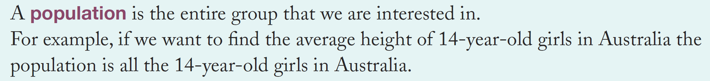
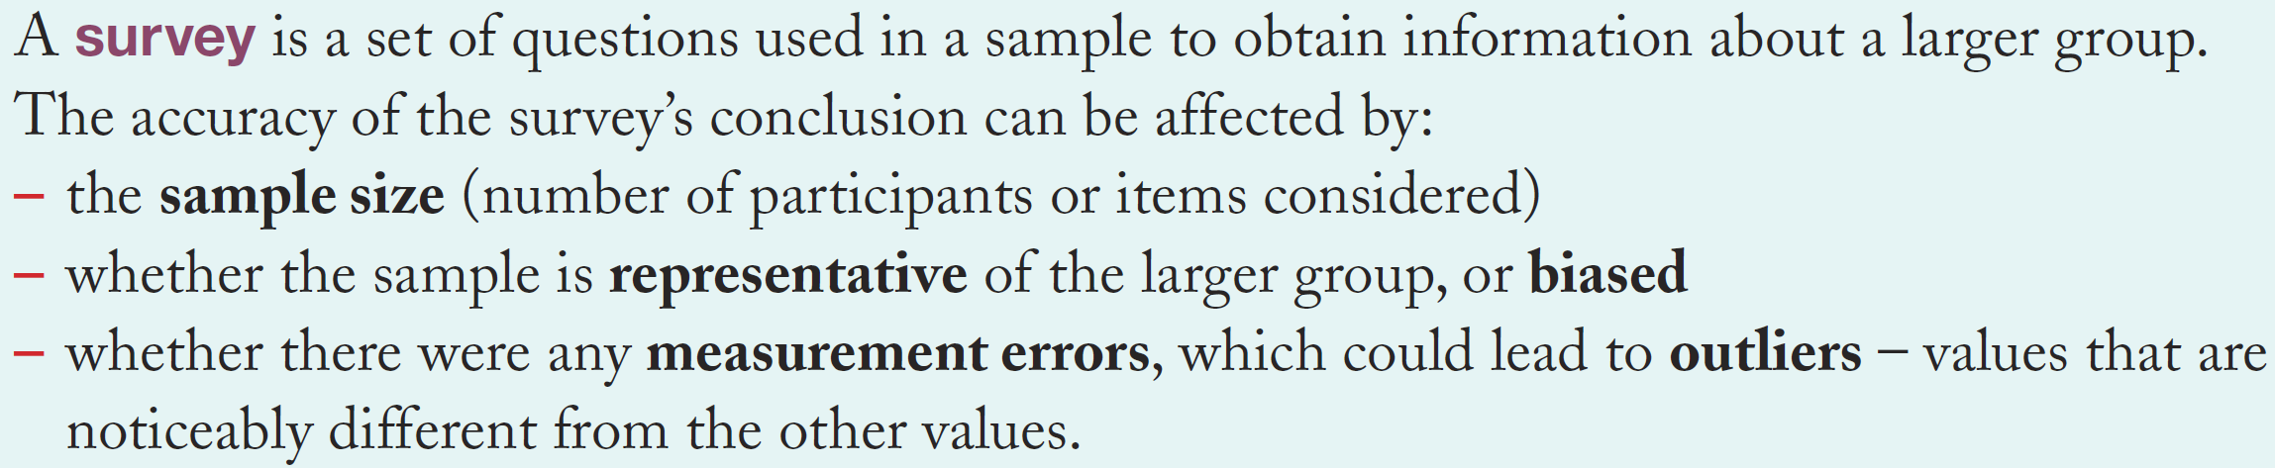
24
7
30
Analysing Data
Date
EQ – How do we analyse data?
What is a population?
What is a survey?

Slide 4
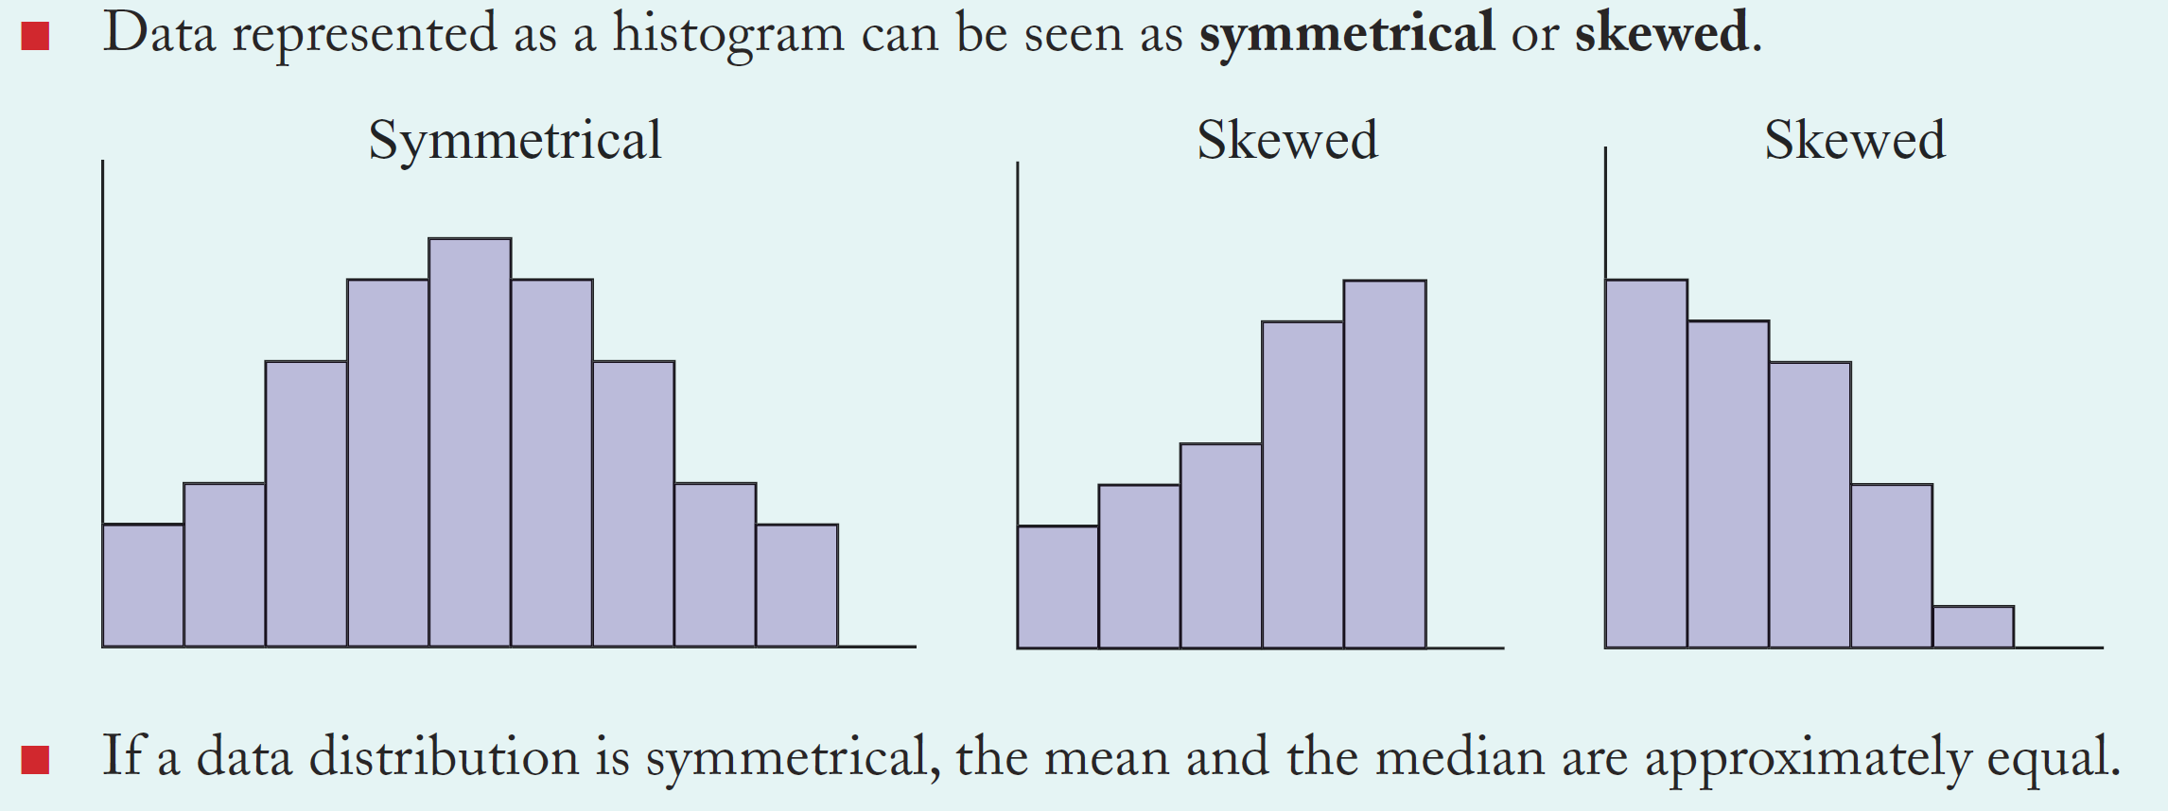
24
7
30
Analysing Data
Date
EQ – How do we analyse data?
How do we analyse a graph?

Slide 5
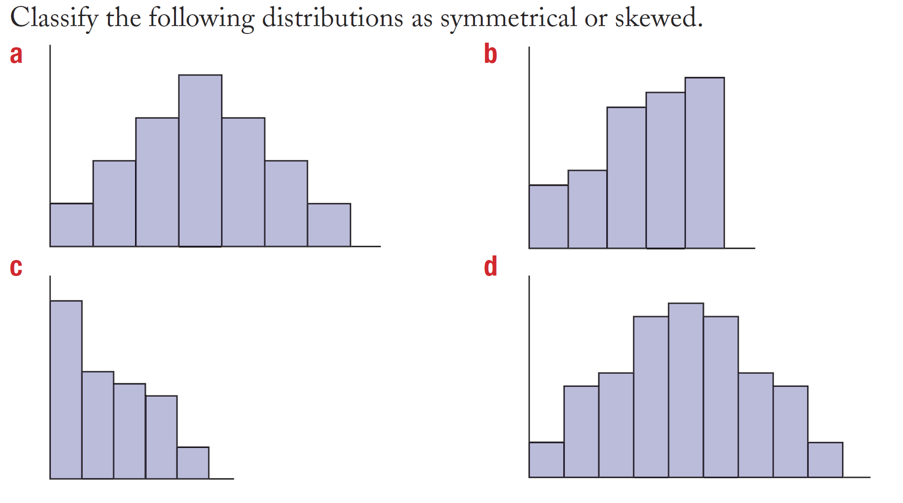
Practice

Slide 6


Slide 7
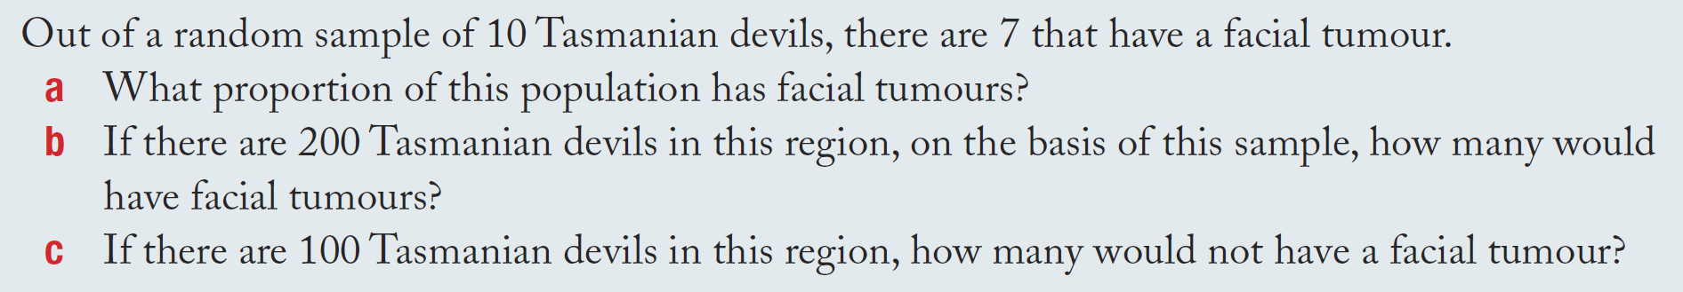
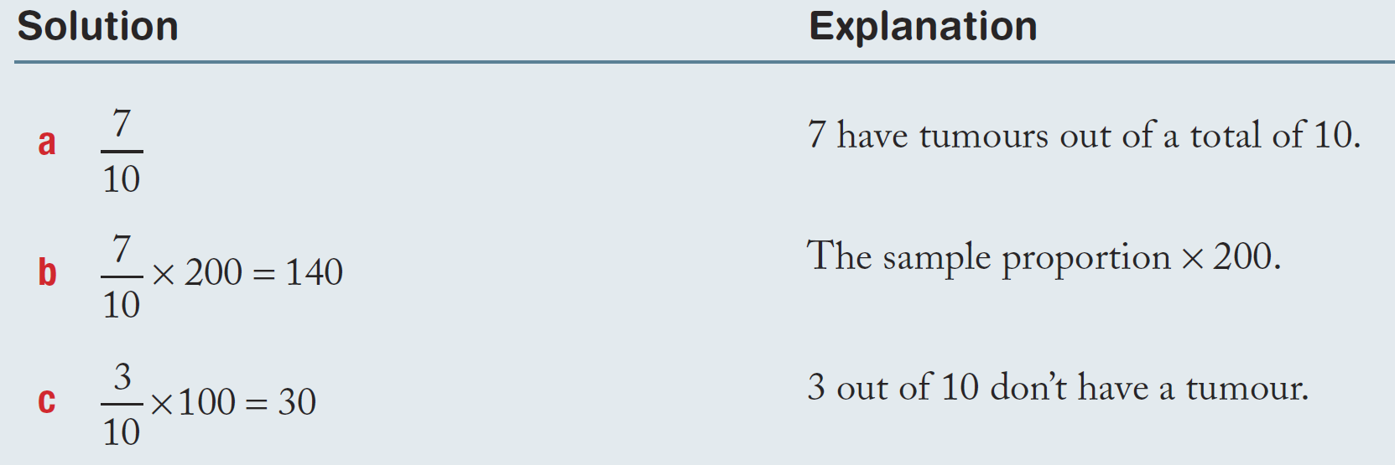
24
7
30
Analysing Data
Date
EQ – How do we analyse data?
How do we work out the proportion of a population?

Slide 8
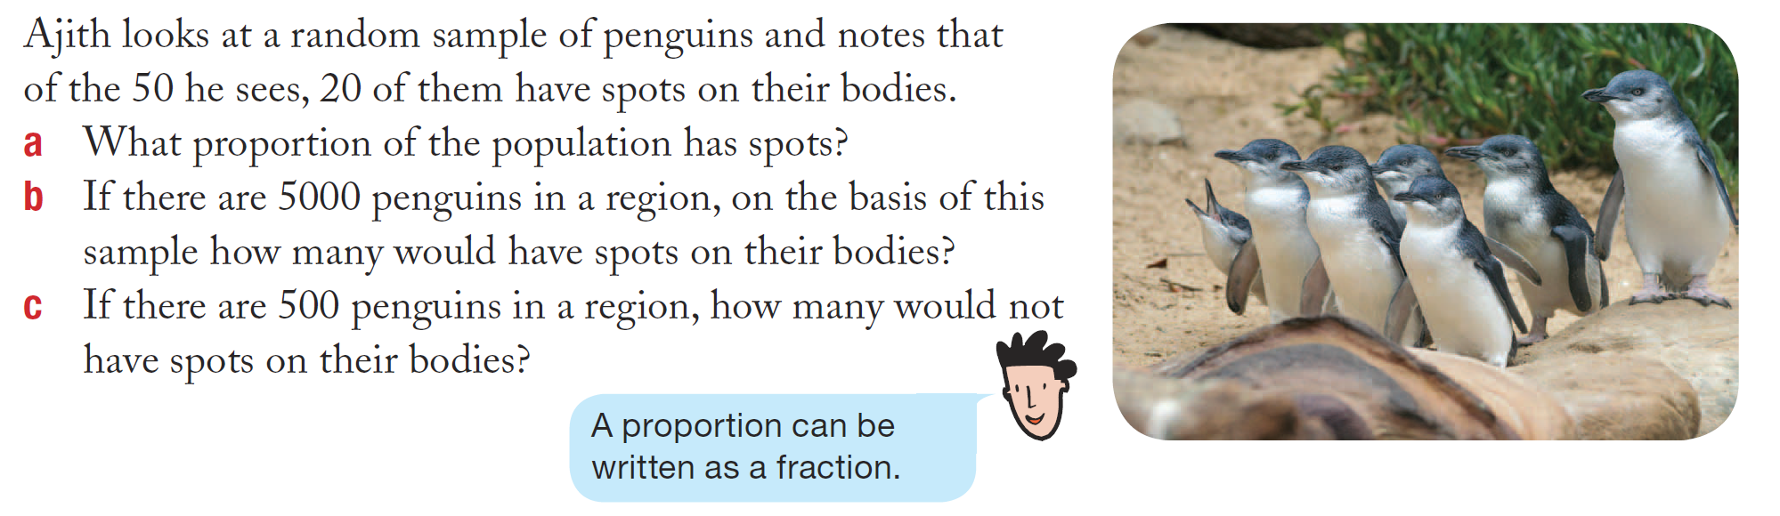
Practice

Slide 9
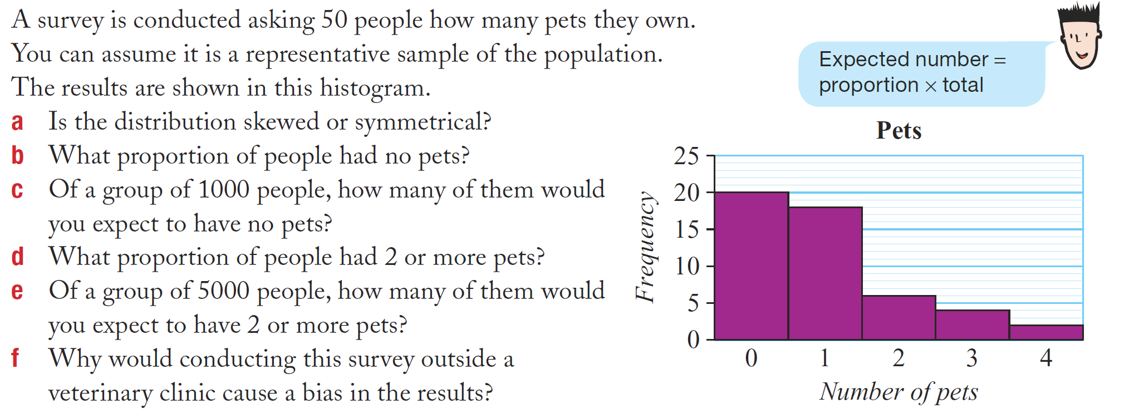
Task

Slide 10
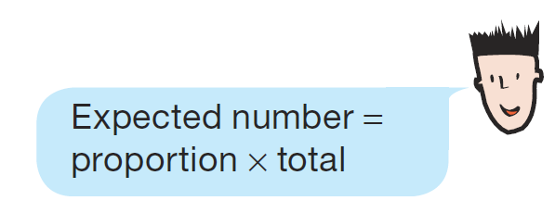
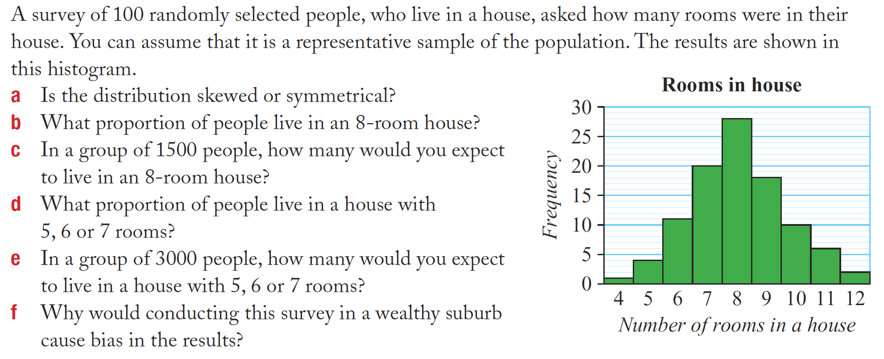
Task

Slide 11
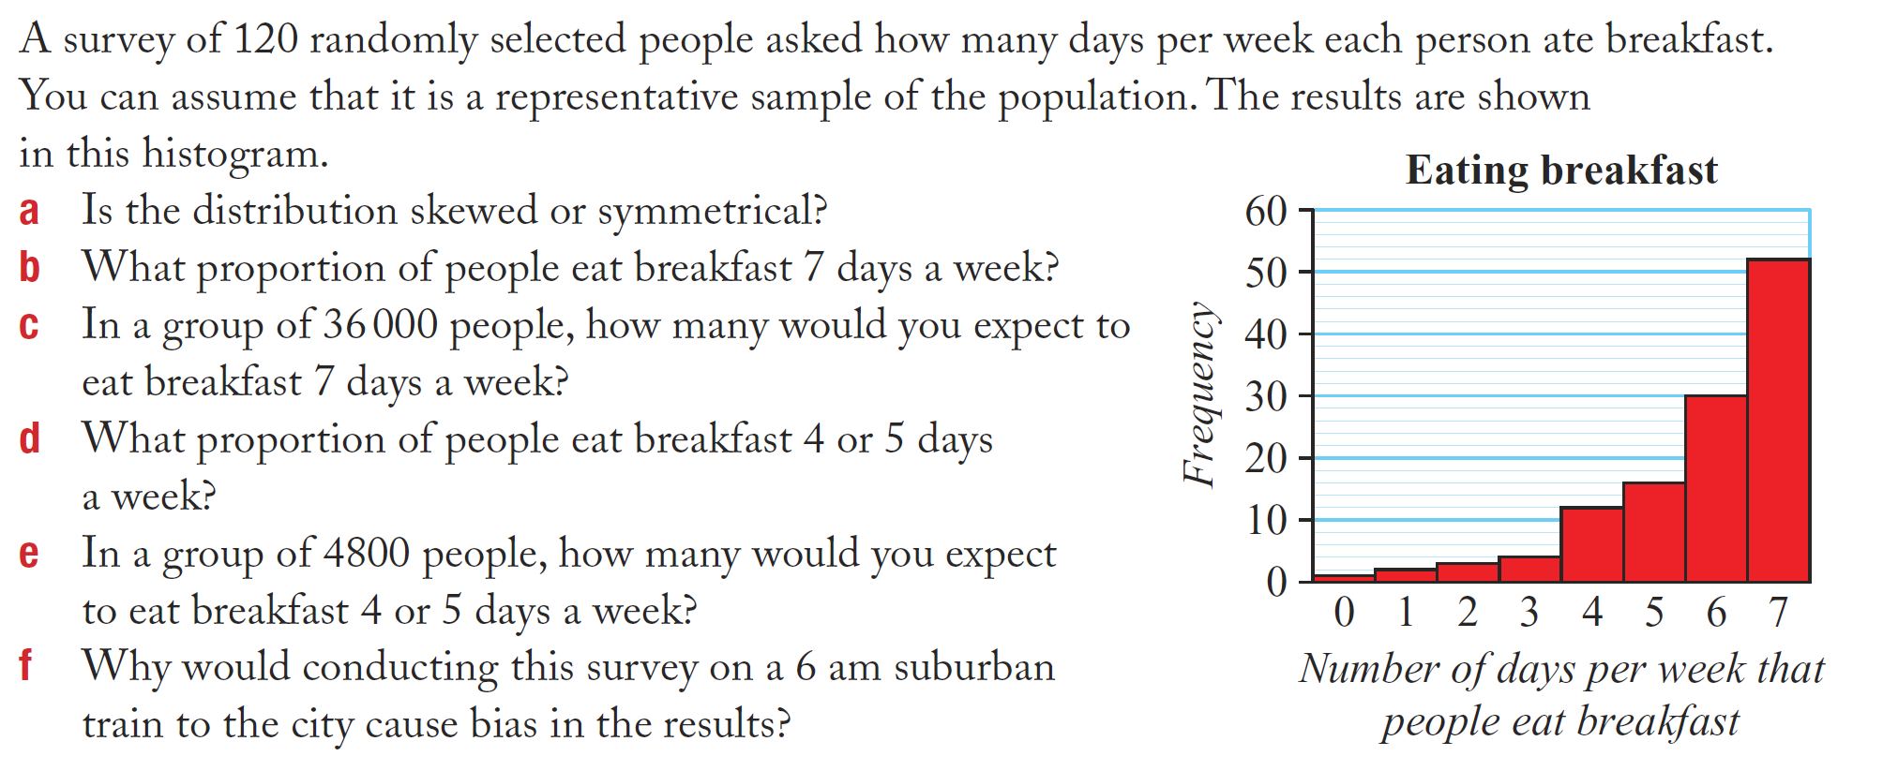
Task

